Slide 1


WHAT IS AIR QUALITY?
How clean the air is around us

Slide 2
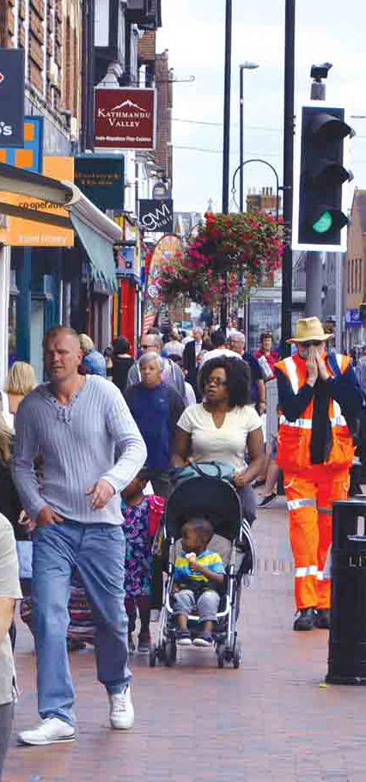
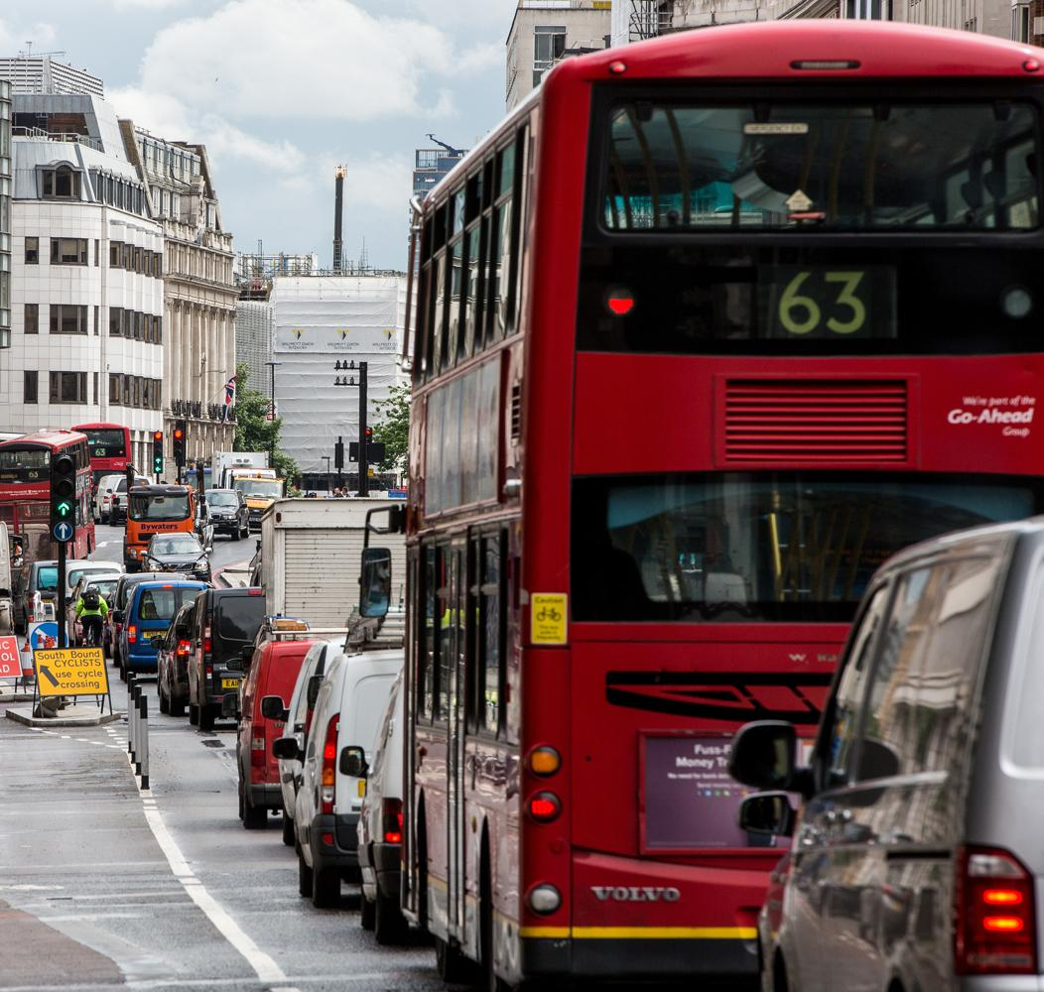
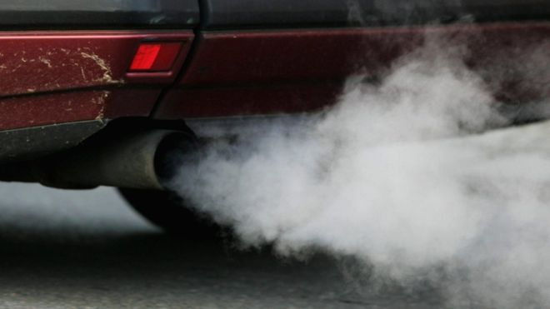
Where is the air pollution coming from?
Notes:
Today’s assembly is about air pollution.
Here’s a normal, busy high street. Can you see any pollution?
Then close-up of vehicle exhaust from cars. Nasty stuff coming up from back of cars – fumes.
Then heavily congested from main road highway – what do you think happens - nasty stuff from cars? Where does it go? Show people on the street
Images from BBC and Alamy

Slide 3
WHERE DOES
AIR POLLUTION
COME FROM?
Your first challenge…

Slide 4













TASK 1. LABEL EACH CAUSE CARD
5 MINUTE CHALLENGE
DUST STORMS

Slide 5

TASK 2. MAKE A POSTER
SHOWING THE CAUSES OF AIR POLLUTION
Sort each cause into it’s correct columns –
are the causes ‘man made’ or ‘natural’?
MAN MADE
NATURAL
5 MINUTE CHALLENGE

Slide 6

HOW CAN WE IMPROVE AIR QUALITY?
Choose to walk, cycle or scoot to school
Park and stride (aim for a 5-10 minute walk)
Choose a route to school that avoids busy roads
Hold an anti-idling campaign
Use public transport
Save energy – switch lights off
Don’t use single use plastic
Encourage recycling

Slide 7





TASK 3. DEVELOP A CAMPAIGN
Start making a plan to improve air quality at your school
TIPS:
to creating your campaign
Choose ONE way that your school can improve air quality per group.
Decide what change/s you want to make.
Decide the messages you want to share.
Make a poster or plan an activity to share your campaign.
10-15 MINUTE CHALLENGE

Slide 8
TASK 4. INVESTIGATING SOME MYTHS OF AIR POLLUTION
Think about the following statements – are they true or are they false?
TRUE OR
FALSE?
5 MINUTE CHALLENGE

Slide 9
A. Diesel vehicles are often the most polluting vehicles on the roads

Slide 10
B. You can always see air pollution

Slide 11
C. Walking on the inside of the pavement and away from the road can help you breathe in fewer car fumes

Slide 12
D. You can always smell air pollution

Slide 13
E. The surface area for gases to diffuse through in human lungs is roughly the same size as a tennis court

Slide 14
F. It's always better to be inside a car to protect you from air pollution

Slide 15
True: A, C, E
False: B, D, F

