Slide 1


WHAT IS AIR QUALITY?
How clean the air is around us
Notes:
Introduction to air quality assembly
Explain to the children that today’s assembly is all about air quality.
Ask them if they have heard of air quality before, or have any idea at all, what it might be about?
Clue: it’s about Air…
We’re talking about air pollution and how clean the air is around us. Air quality is a scientific measurement of how clean the air is.

Slide 2
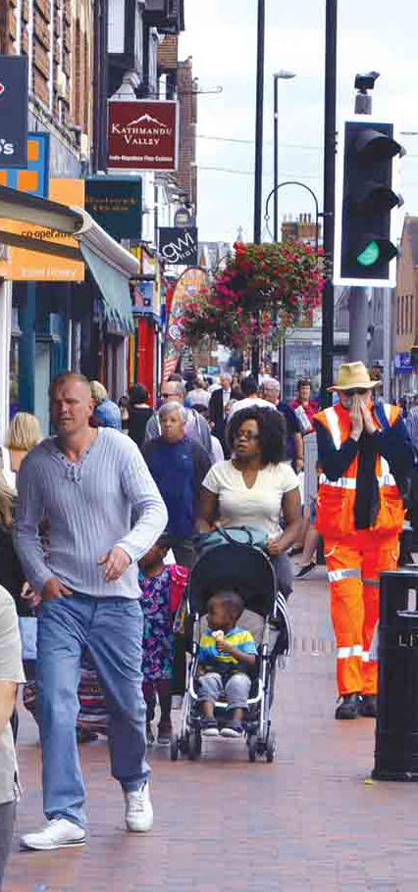
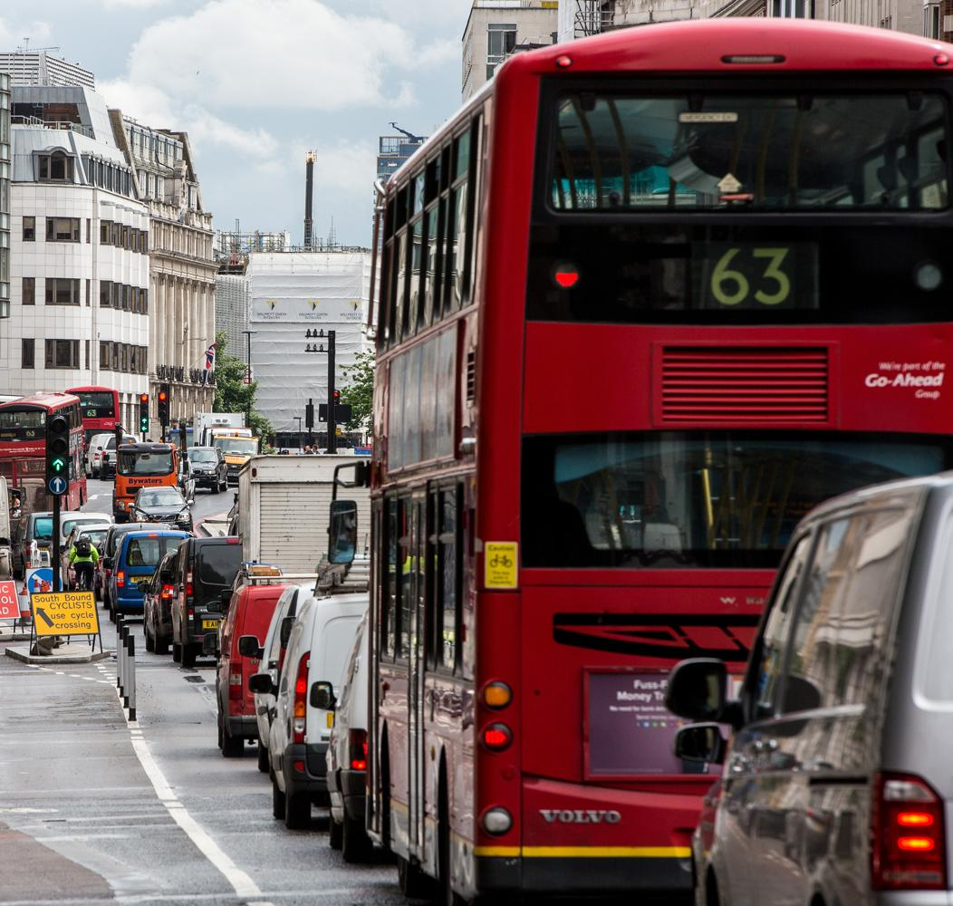
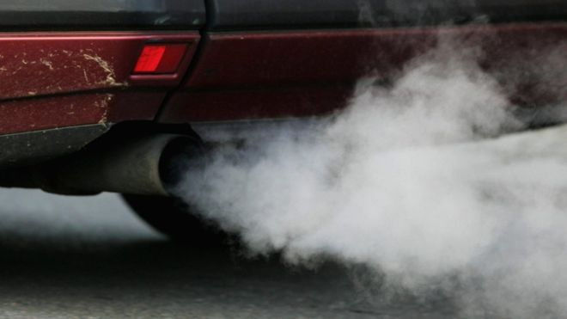
Where does air pollution come from?
Solid particles
Gases
Liquid droplets
Dust
Notes:
Where does air pollution come from?
Here is a picture of a busy high street in London.
Can you see any pollution? Ask the children if they can see any signs of air pollution, or if they can spot what might be causing air pollution…
Answers might include:
Transport: cars, vans, lorries, buses..
Road works
Factories or houses / buildings in the background
Fast food restaurants
Traffic lights – electricity that has been made elsewhere…
Ask the children where most of the air pollution is coming from… vehicle exhausts.
Air pollution is made up of lots of different things, it’s not all gases, it can be made of dust, tiny solid particles (we call those particulates) and liquid droplets.
Fun fact: 70% of air pollution (in urban areas) come from vehicles
Images from BBC and Alamy

Slide 3
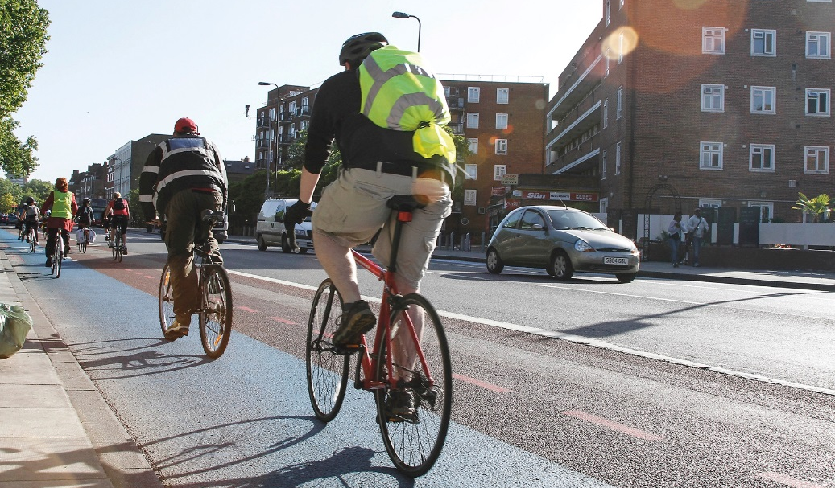
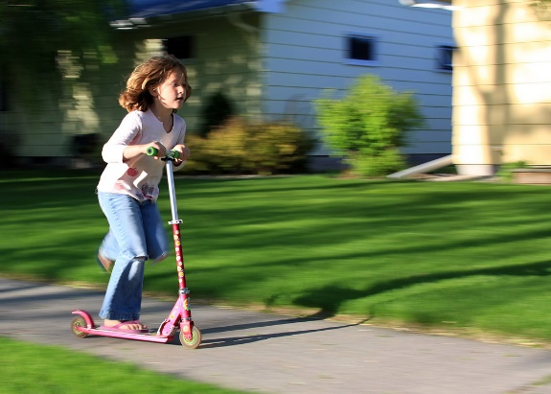
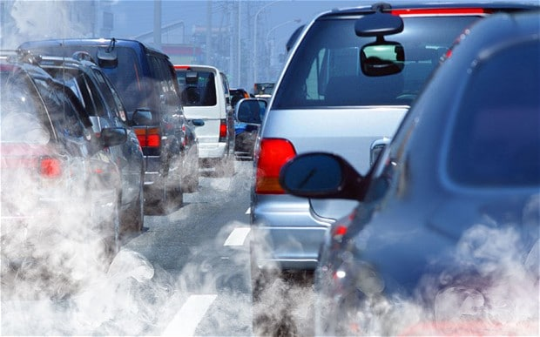
How do you get to school?
Do you… Walk? Cycle? Scoot?
Bus? Train? Taxi? Drive?
Which of these ways of travelling do they think are worst for making air pollution?
Which of these ways make the least air pollution?
Notes:
How do you get to school?
**Optional opportunity for participation.
How do you get to school, most days of the week? Ask the children to raise their hands when asked if they get to school the following ways: Walking, cycling, scooting, bus, train, taxi, car, park and stride (you can add in roller skates, skateboard, flying carpet, horse or jet pack – to liven up the discussion)
**Which method of travel is the least and most polluting?
Ask for a volunteer to be your representative: car driver, bus driver, walker, cyclist and scooting champion
Explain to the children that there is now an invisible line on the floor – this is a sliding scale – starting at one end we have the mode of transport that emits the LEAST amount of pollution… and as we travel along the line, modes of transport emit more and more air pollution, with the mode of transport emitting the MOST at the opposite end.
Ask the audience to help manoeuvre each mode of transport along the line, thinking about how much pollution each mode of transport emits. Ask each child to stand still when the audience agrees that they are in their correct spot.
Correct order:
LEAST polluting
Walking – emission free, but walking will disturb dust on the road / pavement
Scooting – emission free, but will produce a very tiny amount of particulates due to wheel wear from braking and moving around
Cycling – emission free, but will produce a very small amount of particulates due to wheel and brake wear
Bus – individually, will be more polluting, but fewer appear on the roads compared to cars (38.4 million vehicles licensed for use on the roads in Great Britain in 2019 – this number is increasing all the time) There are only 32,000 buses on the road in the UK.
Car – by far the most polluting in quantity – considering the number of journeys undertaken and that most cars only hold one passenger at a time.
MOST polluting

Slide 4
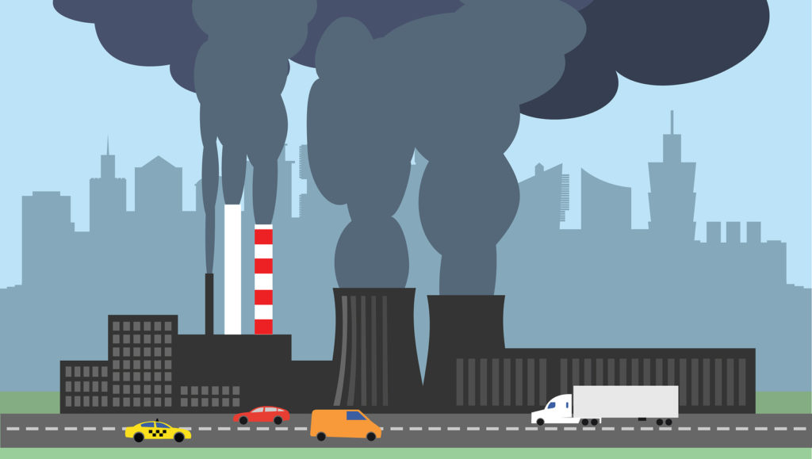
Most air pollution in urban areas, comes from things like this…
Notes:
Air pollution can be caused when we burn fossil fuels such as coal, natural gas, diesel or petrol.
We use these energy supplies for cooking and washing at home, for turning on our lights, heating our homes and travelling by car.
Most air pollution is man made – and comes from road transport and diesel vehicles. However, power stations and factories are hugely polluting too.
The most concerning pollutants that can make you unwell:
Nitrogen Dioxide (NO₂) - this can irritate the lining of your lungs.
Particulate Matter (PM) - these are tiny particles of dust, soot or liquid which are too small to see. These can sometimes go deep into your lungs.
Ask the children, where else might air pollution come from? Can they think of any other sources – man made or natural?

Slide 5



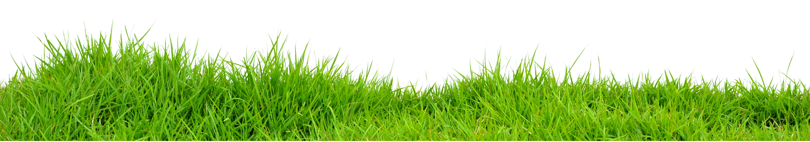

Where else can air pollution come from?
Notes:
Other sources of air pollution:
Our homes are big sources of air pollution – burning fuel in open fires or log burners
Farming is the biggest cause of rural air pollution – from farm vehicles, livestock, spraying fertilisers etc. Rice paddy fields in places such as china and India are another source of methane pollution
Fun fact: How does a rice paddy produce methane (it’s a bit technical for little ones, but nice to know: When rice is grown under puddled transplanted conditions, paddy soil becomes anoxic − depleted of dissolved oxygen − and then, in the absence of oxygen, microbes that break down plant matter produce methane.)

Slide 6





Air pollution can be found inside too!
Notes:
Other sources of air pollution: Air pollution can be found indoors too…
Air pollution can also be found indoors too…
Where do you think we might find air pollution in our houses?
Smoking – smoke particles
Paint and cleaning products – VOCs – the fumes given off when we use them (these can even be found in furniture, flooring and carpets)
Airborne particles: dust, pollen etc
Odours
Cooking
Heating – log burners, open fires, boilers
Extra info for teachers / those interested:
Tips for reducing indoor air pollution:
Open windows
Use a damp cloth for cleaning
Use liquid cleaners rather than sprays
Don’t smoke inside
Use fragrance free cleaning products – these tend to be lower in VOCs

Slide 7



Natural causes of air pollution
Notes:
More sources of air pollution….
Air pollution can also be made naturally.
Ask the children if they can think of anything that might cause air pollution naturally…
Examples might include:
Volcanoes
Forest fires
Lightening strikes
Dust storms
Biological decay – decomposition of living things

Slide 8
WHAT’S THE PROBLEM?
Health
Environment
Notes:
What’s the problem with air pollution?
Talk to pupils about the effect of air pollution on their health.
Air pollution can contribute to breathing problems, the development of asthma, and lung and heart diseases. The risks are greater for children, as your bodies are less resilient and still developing. Because of your height, you are also closer to the exhaust fumes from cars. Studies have also shown that living in very polluted areas can stop your lungs growing properly, which could cause health problems later in life. But if we do something about it and cut pollution, we can reverse some of this damage.
What other impact does air pollution have on the environment? Pupils may also know about how burning fossil fuels also creates global warming / climate change. As well as causing acid rain, which can affect plants and trees. It can also affect animal health, in the same way that it harms us.

Slide 9
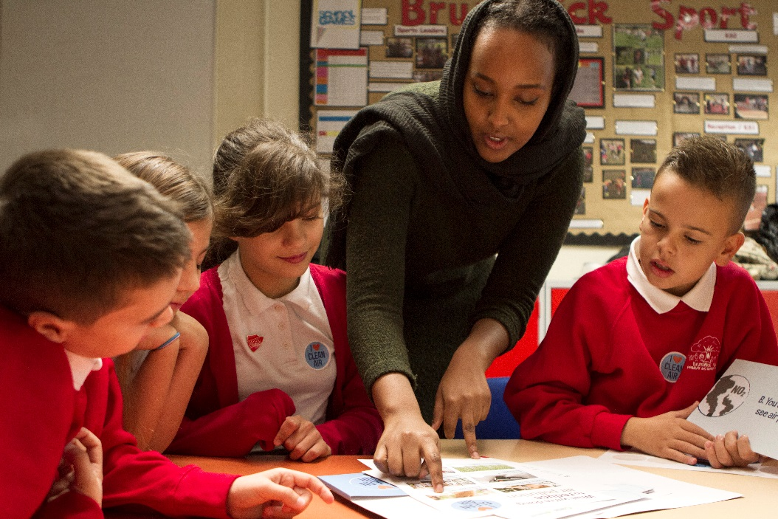
What can we do to reduce air pollution?
What are your ideas?
Top tips:
  Do today
  Do this week
  Do this term
Notes:
What can you do to help?
Even though air pollution has many causes, there are always little things we can all do to help… No matter how small, every change counts and will help to reduce air pollution if we all work together.
Ask the children for their ideas. What could they do to help improve air quality?
Summarise ways that each child can help:
Today – switch off lights and electronic devices when we don’t need to use them (teachers – this includes white boards, computers and tablets)
This week – if coming in the car every day, why not try and park and stride one day? Pick a spot and time how long it takes to get to school. Try and aim for a 10 minute walk to school from your parking spot – this is a good park and stride.
This term – could you try coming to school in a different way altogether? Why not try walking or cycling to school instead once a week, to see how you get on?

Slide 10


Have you got any questions?
Thank you!
Danni Kennell
Education Officer (Air Quality) Leicester City Council
Any questions?
Notes:
Any questions?

