Slide 1







Switch your engine off for cleaner air!
Notes:
Launch assembly for Switch off your engine for cleaner air campaign.
Introduce assembly through asking children if they have seen the switch your engine off for cleaner air posters outside of school.
Ask children why do they think we need to switch our engines off for cleaner air – what’s the problem with leaving our engine on?
Air pollution – lots of toxic pollutants in engine emissions and particulate matter is harming our health and the environment.

Slide 2





What do these have in common?
Picking your nose
Biting
your nails
Not brushing
your teeth
Watching too much TV
Bad Habits
Spending too much time on a tablet or smart phone
Drinking too much fizzy pop
Eating too many sweets
Notes:
Ask the children what do these items having in common?
Watching too much tv
Drinking too much fizzy pop
Eating too many sweets
Spending too much time on a tablet or smart phone
Not brushing your teeth
Biting your nails
Picking your nose
… All are bad habits…
Everyone has a bad habit. A bad habit is something that people keep doing, when they know they’re not supposed to…
Today’s assembly is about one bad habit in particular… engine idling!

Slide 3
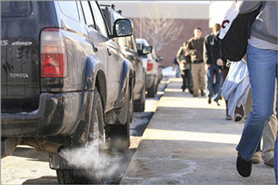





What is idling?
Idling happens when you leave the car engine running, after you have stopped or parked.
Notes:
But what is engine idling? I hear you cry?
Idling happens when you leave the car engine running (and after you’ve parked or the car has stopped for more than 1 minute).
Examples of idling:
Engine left on when…
- Parked outside of school at home time, or when dropping children off at the school gates
- Parked outside of the shop (even if you’ll only be one minute!)
You are NOT idling when:
Your engine is left on when…
- You’re stopped at the traffic lights waiting to go
- You’ve stopped in a traffic jam on the motorway (although, if it is a long time, you could switch your engine off if you haven’t moved for a while)

Slide 4



WHAT’S THE PROBLEM?
It’s confusing
Idling is breaking the law
It’s bad for
the environment
and our health
Wastes fuel and money
Notes:
What’s the matter with leaving the engine running? Why is it a problem?
It’s confusing – If a car has it’s engine running, but it’s parked – is it staying or is it going?
It wastes money and fuel – think about all of the petrol / diesel being wasted – money literally going down the drain. Did you know that you could also be fined up to £70?
Idling is bad for the environment – vehicle emissions contain harmful and toxic chemicals, which is bad for us* and the environment*.
Idling is breaking the law. "Stationary idling is an offence under section 42 of the Road Traffic Act 1988" and don’t forget the Highway code - Rule 123 states: “You must not leave a vehicle’s engine running unnecessarily while that vehicle is stationary on a public road."
*How air pollution harms health: https://www.gov.uk/government/publications/health-matters-air-pollution/health-matters-air-pollution
*How air pollution harms the environment: https://greentumble.com/environmental-impacts-of-air-pollution/

Slide 5
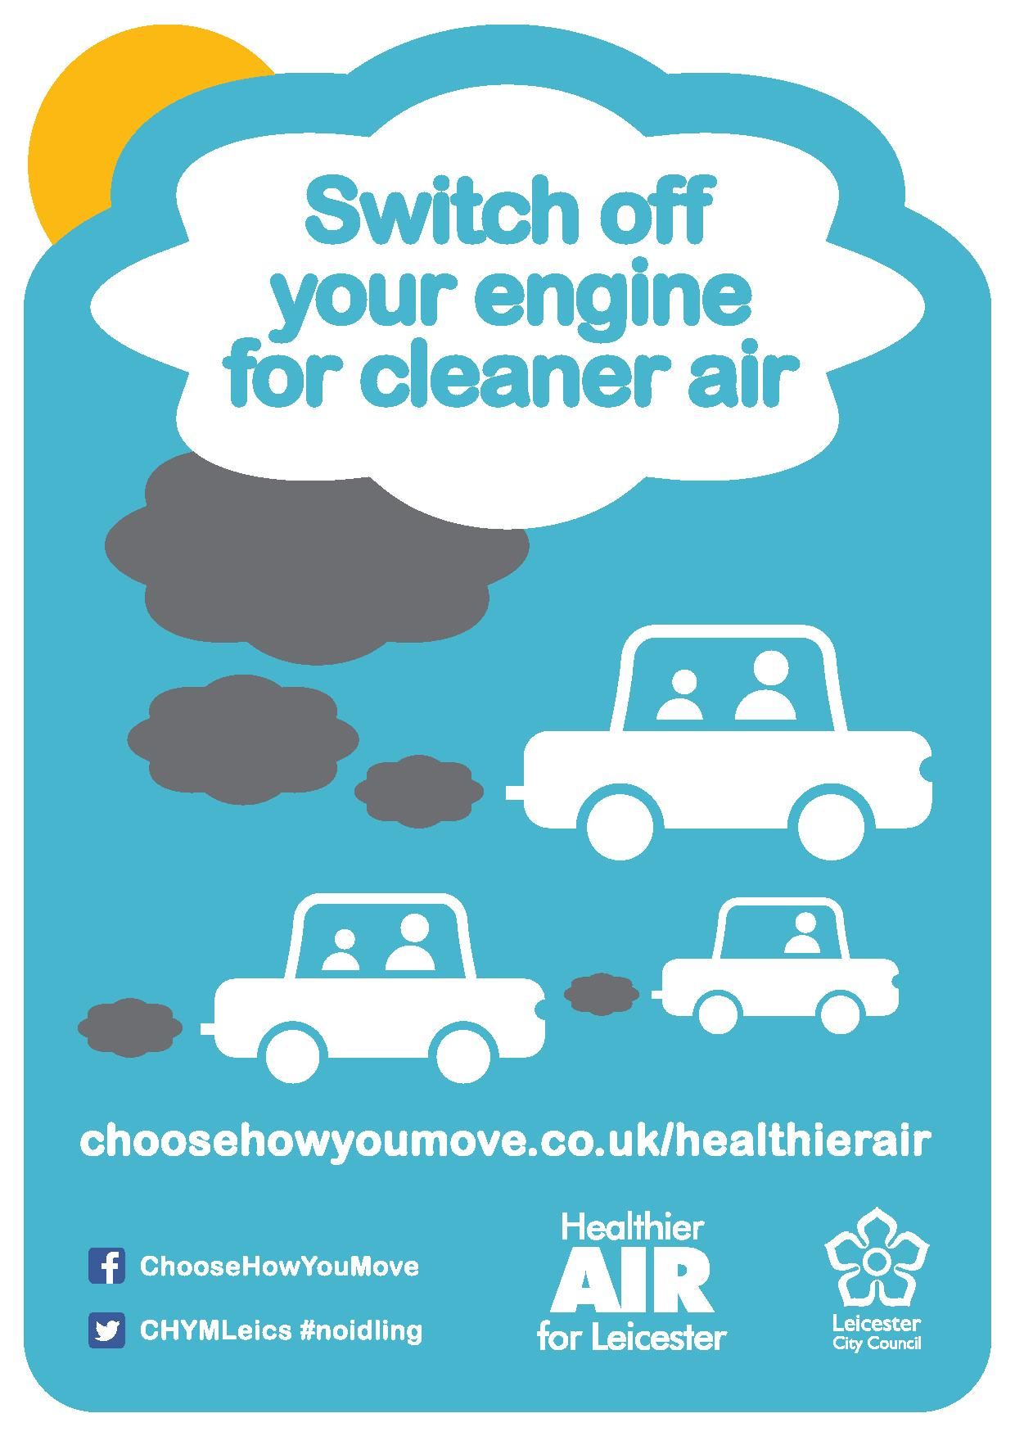
What can you do to help?
Walk, cycle
or scoot to school
Spot the sign
on your way to school!
Ask drivers to
switch their engine off for cleaner air!
Test parents
with the fact and fiction on the back!
Notes:
What can we do to help?
Ask the children for their ideas of how they can help.
Explain to the children that the switch your engine posters will appear, if not already up around the school gates and areas known for problem idling. Each child will also be given a flyer to take home in their book bag.
Make sure you give the flyer to whoever looks after you
Play spot the sign on your way to and from school – point it out to who is looking after you – tell everyone what it means and why it’s the right thing to do – to switch our engines off for cleaner air
Get to school more actively, try at least once a week at first and build it up. Take up waking, cycling or scooting if you can. Park and stride is also an option. Check awareness of park and stride (how many minutes walking should you do after you park up, for a good park and stride?
Read through the fact and fiction on the back of the flyer – and test your parents.
Ask drivers NICELY to switch their engines off for cleaner air. Don’t go approaching anyone by yourself.

