Slide 1

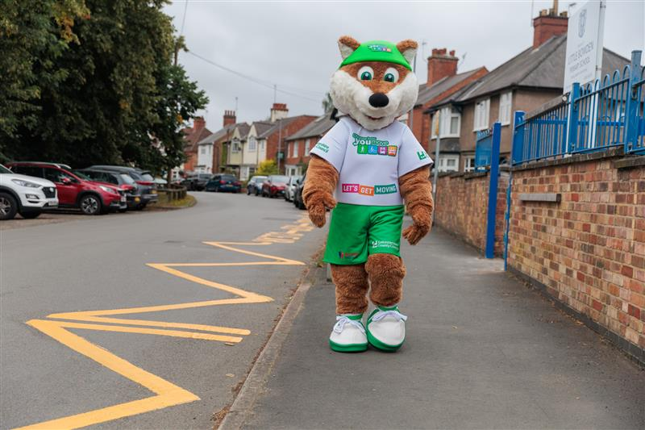
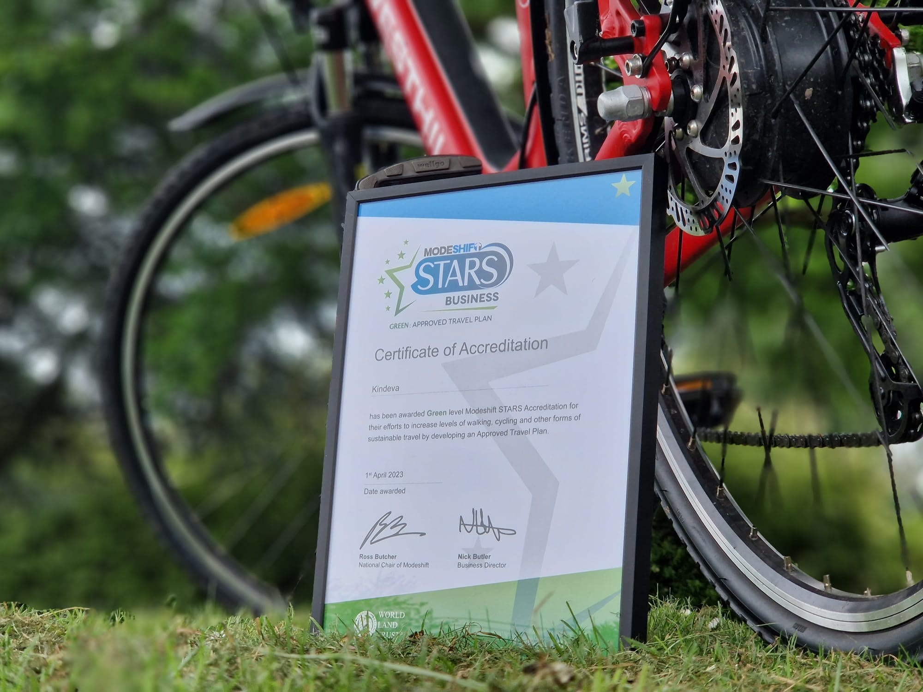
ACTIVE TRAVEL MONTH SPECIAL
School • Walking • Cycling • Scooting • Wheeling • Active Travel
October 2026: Choose an Active Journey
Active Travel Month
October is Active Travel Month and a fantastic opportunity to encourage pupils, staff and families to swap the car for a healthier, more sustainable journey.
Whether it's walking, wheeling, cycling or scooting, every active journey helps reduce congestion around the school gate, improve air quality and support healthier lifestyles.
Keep an eye out for activities and events taking place throughout the month and let us know how your school is getting involved.
Don't forget to keep an eye on the Schools Travel Calendar on our website. The calendar highlights:
National campaigns, Awareness days, Active travel events, Competitions, Key school dates.
Theo’s encouraging pupils to walk, wheel, cycle and scoot to school.
Cycle to School Week
Monday 5 October to Friday 9 October 2026
Cycle to School Week is a fantastic opportunity to encourage pupils and staff to travel actively and enjoy the many benefits of cycling.
Why not organise a bike breakfast, celebrate pupils who cycle to school, or encourage families to give cycling a try during the week? Remember to carry out a quick bike safety check before setting off and ensure bikes are roadworthy and ready to ride.
Modeshift STARS
Modeshift STARS Accreditation Reminder
Schools working towards Modeshift STARS accreditation are encouraged to keep their activities and evidence up to date throughout the autumn term to avoid the rush ahead of submission deadlines.
Key date: The Modeshift evidence submission deadline is December 2026.
If you need support with your accreditation journey, please contact the Sustainable Travel Team. Modeshift will also be holding a Education Masterclasses, covering all aspects of Modeshift STARS. The masterclass will be held on 4th of November 2026, from 15:45-16:30, and you can register here.
Share Your Active Journeys!
Taking part in Active Travel Month?
We'd love to see how your school community is walking, wheeling, scooting and cycling throughout October.
Follow and tag us:
📘 Facebook: @ChooseHowYouMove
📸 Instagram: @choosehowyoumove_
🐦 X: @CHYMLeics
Tag us in your photos and stories throughout October and show us how your school is travelling actively!
Accreditation Certificate

Slide 2
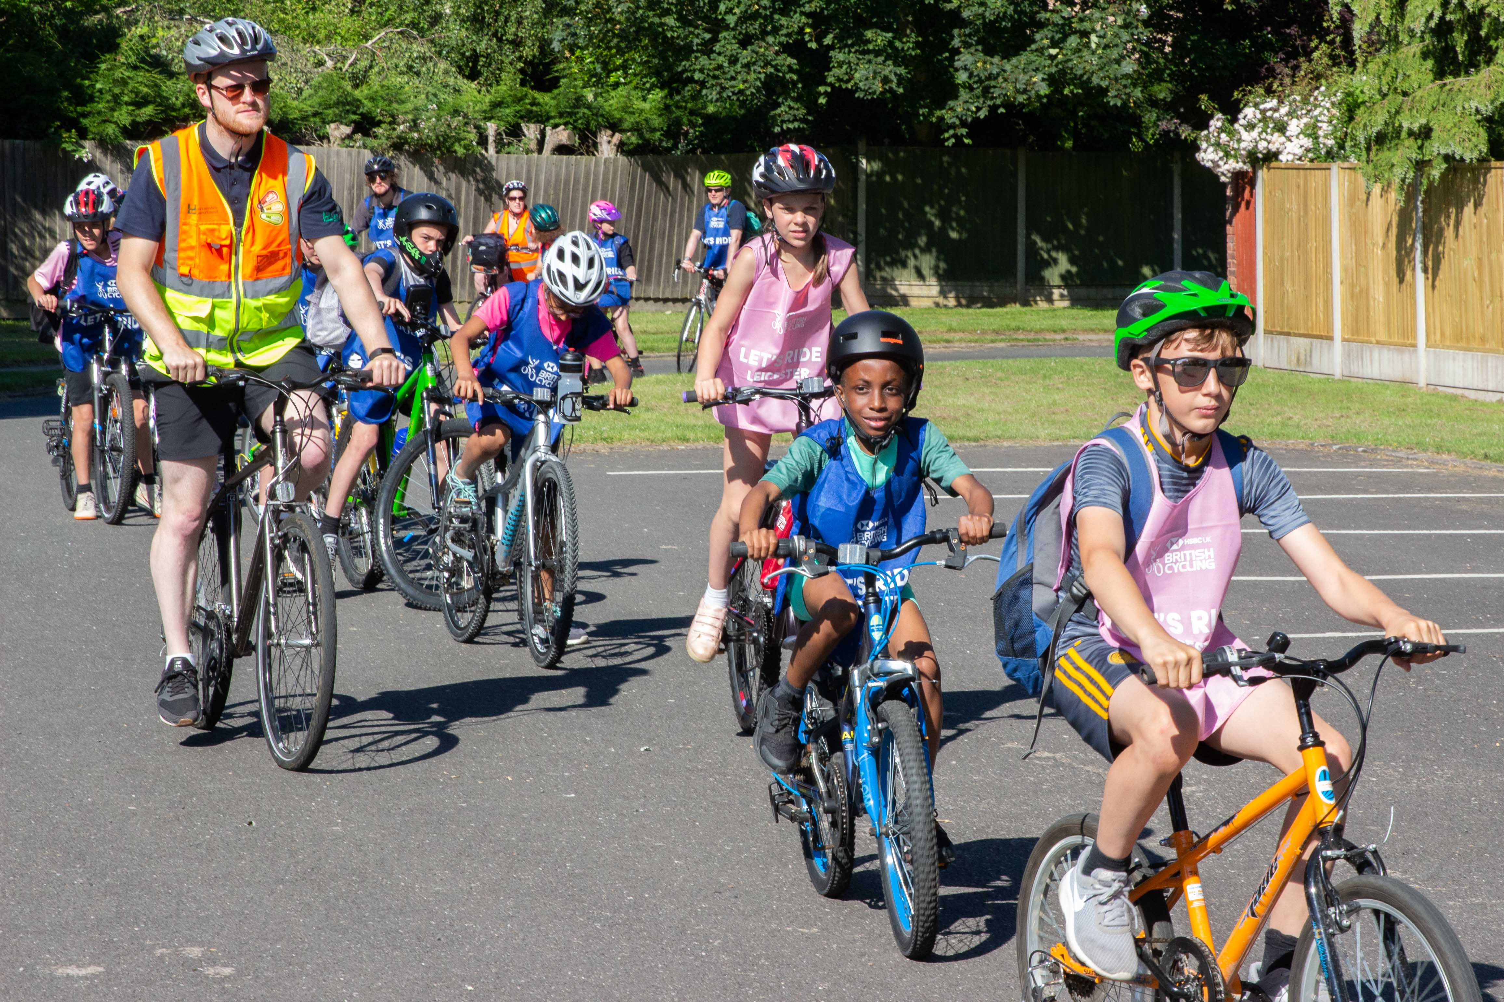
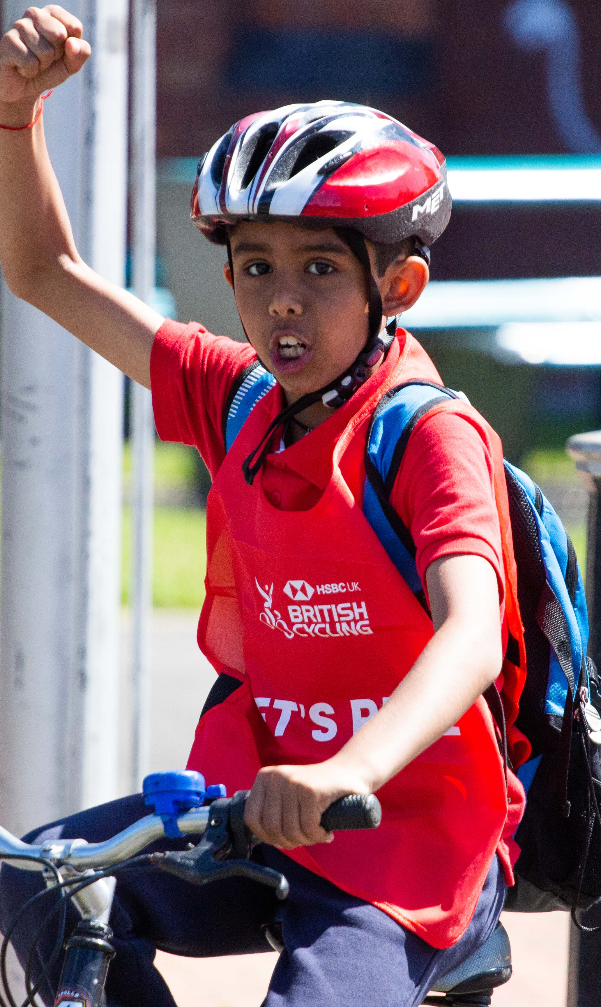
School Grants
Primary School Active Travel Grants 2026/27:
Help enable more active and sustainable travel to your school by applying for an Active Travel Grant. Schools can apply for up to £1,000 to fund anything that encourages active and sustainable travel. This could include:
Bicycle repair workshops or maintenance equipment.
Equipment for a walking bus.
Walking, cycling or scooting challenges and reward schemes such as the Wow Travel Tracker
Bikes and Scooters
Applications open on Monday 14th September 2026 and close on Friday 30th October 2026.
Visit the CHYM website for more information and how to apply!
Pupils enjoying a school-led Ride
Better Points
Schools, staff, parents and pupils can continue to get involved with BetterPoints, our rewards-based app that encourages sustainable travel choices.
Participants can earn points and rewards by choosing active and sustainable modes of transport,
including:
Walking
Cycling
Scooting
Public transport
We would be grateful if schools could help promote BetterPoints through newsletters, websites and social media channels.
Sign up here!
Set, Pedal – Go!
Set, Pedal-Go! is a programme designed to help Year 5 and 6 pupils learn to ride a bike. Schools that take part receive bikes, free staff training, bike maintenance support, and guidance on setting up a bike library. This allows pupils to borrow bikes and continue developing their skills outside of school. The programme promotes physical activity, improves mental wellbeing, builds confidence and independence, and encourages healthy and sustainable travel habits. Active Together are also seeking donations of unwanted bikes to refurbish and redistribute through the scheme, with schools able to volunteer as community drop-off points. Schools already involved have reported positive outcomes, including increased confidence, greater participation in cycling activities, and more opportunities
for pupils to travel actively.
Click here to get involved!
Park and Stride Need to drive part of the journey?
Park and Stride encourages families to park a short distance away from school and walk the final part of their trip. This simple change helps reduce congestion and improve safety around the school gates whilst allowing children to enjoy the benefits of an active journey.
If your school would like support exploring a Park and Stride scheme, please get in touch with the Choose How You Move team at choosehowyoumove@leics.gov.uk
Active Travel in action!

